Slide 1
Introduction to Flex Box

Slide 2
Agenda
In this session, we will discuss:
Flexbox – Introduction
Flex Container
Flex Items
Flexbox Layout
Flex Direction
Flex-wrap
Justify Content
Align Items
Gap

Slide 3
Flexbox - Introduction
CSS Flexbox, or Flexible Box Layout, is a layout model in CSS (Cascading Style Sheets) that allows you to design complex layouts with ease.
It makes it simpler to distribute space and align content within a container, even when the size of your elements is unknown or dynamic.
Flexbox is particularly well-suited for creating responsive web designs and aligning items within a single row or column.

Slide 4
Flex Container
To create a flexbox layout, you first need to define a flex container.
This is done by setting the following CSS property:
display: flex;
or
display: inline-flex; on an HTML element.
Elements inside this container become flex items.

Slide 5
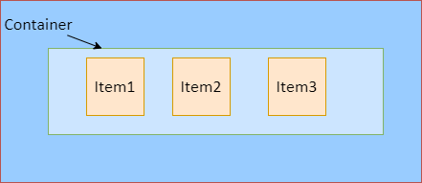
Flex Items
Elements contained within a flex container are referred to as flex items. These items are automatically arranged within the container based on the available space and the rules you define.

Slide 6
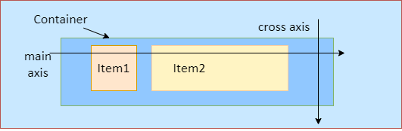
Flexbox Layout
In a flex container, there are two primary axes:
The main axis
The cross axis
The main axis is the primary direction in which the flex items are laid out, and the cross axis is perpendicular to it.

Slide 7
Flex Direction
You can control the direction of the main axis using the flex-direction property. The common values are row, row-reverse, column, and column-reverse. For example, setting
flex-direction: column; //will stack the items vertically.
By default, the flex items are laid horizontally from left to right.

Slide 8
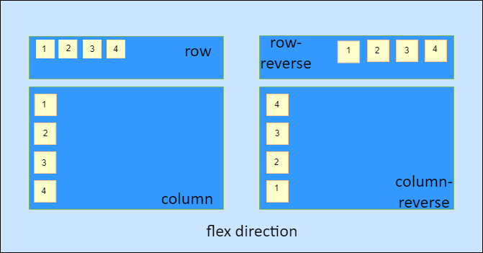
Different Flex Directions

Slide 9
Flex-wrap
By default, flex items try to fit into a single line.
If they overflow the container, you can enable wrapping using the flex-wrap property.
.flex-container {
display: flex;
flex-wrap: wrap;
}

Slide 10
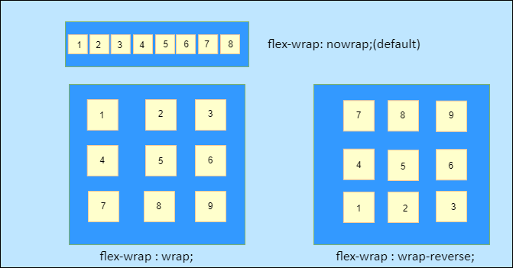
Flex-wrap
By default, the nowrap property is applied which places all the flex-items in one row.
If we apply flex-wrap: wrap the items are wrapped onto the next row from top to bottom.
The flex-wrap: wrap-reverse starts placing the flex-items from bottom to top.

Slide 11
Justify Content
This property controls the alignment of flex items along the main axis.
Common values include flex-start, flex-end, center, space-between, and space-around.
.flex-container {
display: flex;
flex-wrap: wrap;
align-content: space-between;
}

Slide 12
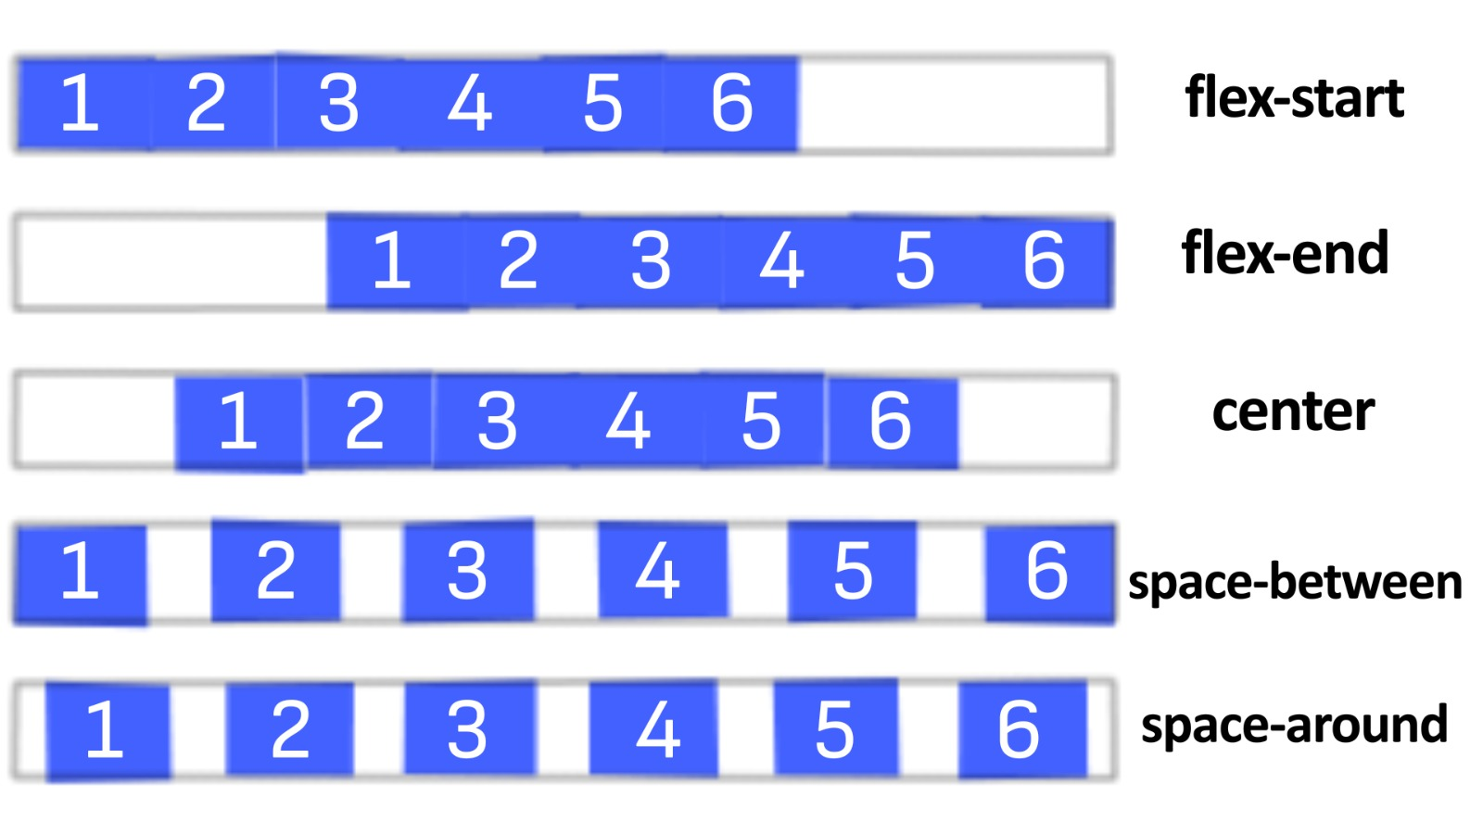
Justify Content
flex-start places all the items to the left side.
flex-end places the items towards right.
center places the items at the center close to each other.
space-between provides equal space between the items.
space-around keeps some space at the left and right side of each item.

Slide 13
Align Items
It controls the alignment of flex items along the cross axis.
Common values include flex-start, flex-end, center, baseline, and stretch.
.flex-container {
display: flex;
align-items: center;
}

Slide 14
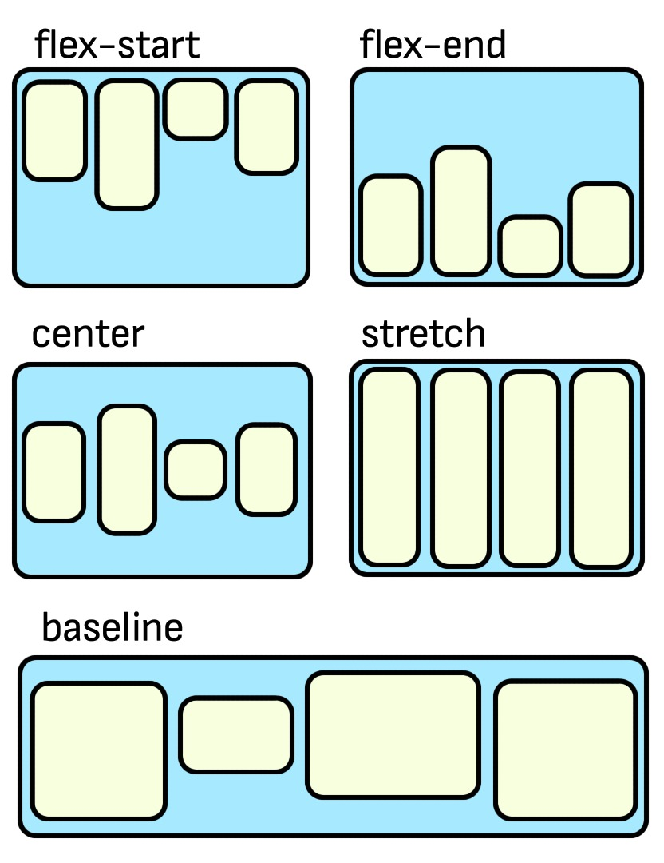
Align Items
flex-start aligns the items to the top
flex-end aligns the items to the bottom
center aligns the items to the center
stretch value stretches the items to fit-in the container vertically
baseline specifies that the flex items should align along their baselines,
which is often the bottom of the text content within each item.

Slide 15
Gap
The gap property is used in conjunction with the display: flex; property to control the spacing between the elements (flex items) within a flex container.
The gap property simplifies the management of spacing between elements and is a shorthand for the row-gap and column-gap properties in flex layout.
Here's how you can use the gap property:
.container {
display: flex;
gap: 20px; /* Sets both row-gap and column-gap to 20px */
}

Slide 16
Summary
Here’s a brief recap:
CSS Flexbox, or Flexible Box Layout, is a layout model in CSS that allows you to design complex layouts with ease.
Flex container has two primary axes: the main axis and the cross axis. The main axis is the primary direction in which the flex items are laid out, and the cross axis is perpendicular to it.
Flex direction is used to control the direction of the main axis using the flex-direction property.
Justify property controls the alignment of flex items along the main axis.
Align item controls the alignment of flex items along the cross axis.
The gap property, when combined with display: flex;, regulates the spacing between elements (flex items) inside a flex container.

